Slide 1

Vel Tech Rangarajan Dr. Sagunthala R&D Institute of Science and Technology
School of Computing
Department of Computer Science and Engineering
10211CS224 / FULL STACK APPLICATION DEVELOPMENT (JAVA)
END SEMESTER PROJECT REVIEW
Date:06-05-2026
SMART JOB RECRUITMENT AND MANAGEMENT SYSTEM
SDG: 8-Decent Work and Economic Growth
Presented By:
THOKALA VARSHITHA CHOWDARY – VTU26428 – 23UECS0568
Courses Handling Faculty:
Dr.HEMAMALINI
Assistant Professor(Senior Grade)

Slide 2
INTRODUCTION
1
A Job Portal is a web-based application that connects job seekers and employers.
It allows users to register, login, and search for jobs easily.
Employers can post job openings and manage applications.
The system reduces manual effort in job searching.
It provides a centralized platform for job opportunities.
Helps students and freshers find suitable jobs.
Improves accessibility and efficiency.
Built using Spring Boot and MySQL.
2
3
4
5
6
7
8
9

Slide 3
PROBLEM STATEMENT
1
2
Traditional job search process is slow and inefficient of a centralized platform for job listings
Difficulty in tracking job applications
Manual systems lead to errors and delays
Limited access to real-time job updates
Job seekers struggle to find relevant opportunities
Employers face difficulty in managing applications
Need for an automated and user-friendly system
3
4
5
6
7
8
9

Slide 4
OBJECTIVE(S)
1
2
3
To design and develop a Job Portal system for job seekers and employers.
To implement a system for job posting, searching, and application management.
After getting accepting or declined the job seeker will get an email meassage.
Through that email the job seeker will get to know whether he/she is accepted/rejected for the job.
4
5
6
7
8
9

Slide 5
PROPOSED SYSTEM
1
2
Provides online job search functionality.
Users can register and login securely.
Employers can post and manage jobs.
Job seekers can apply for jobs easily.
Stores data in a centralized database.
Reduces manual work and errors.
Improves speed and efficiency.
User-friendly interface for easy navigation.
3
4
5
6
7
8
9

Slide 6
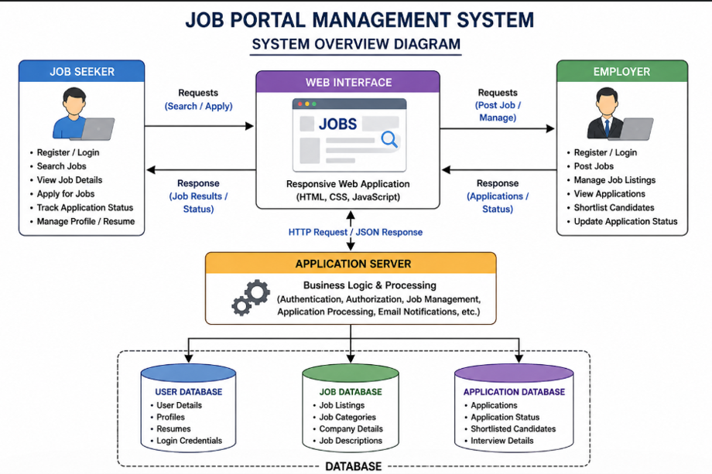
PROPOSED SYSTEM ARCHITECTURE
1
2
3
4
5
6
7
8
9

Slide 7
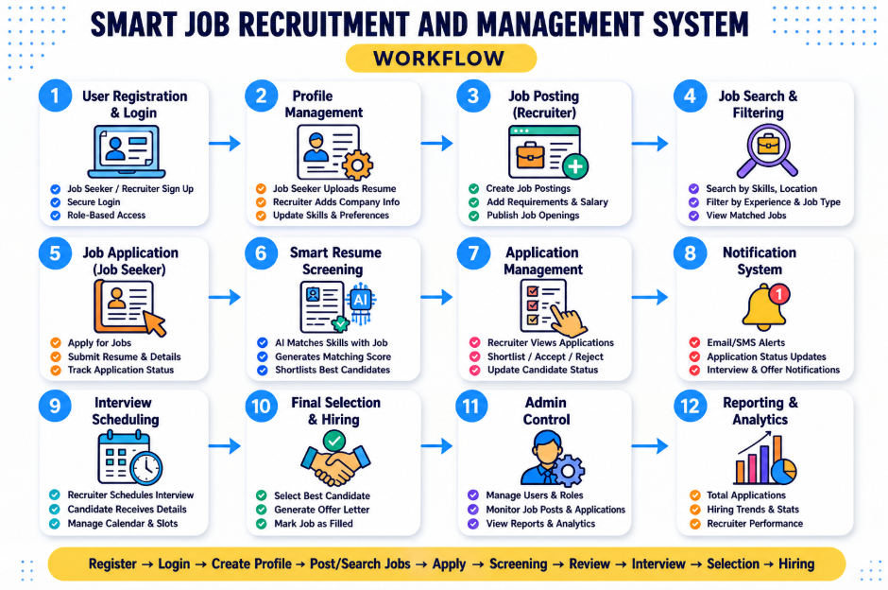
WORKFLOW
1
2
3
4
5
6
7
8
9

Slide 8
TECHNOLOGIES USED
Frontend: HTML5, CSS3, JavaScript, and Bootstrap for building a responsive and interactive user interface.
Backend: Java with Spring Boot framework to handle server-side logic, REST APIs, and business operations.
Database: H2 Console for storing application data such as user details and records securely.
Tools: Eclipse for development, Postman for API testing, and Maven/Gradle for project build management.
Hardware/Software Requirements: • Hardware: Minimum 4GB RAM, Dual-core Processor, and 20GB available disk space. • Software: Windows 10/11 or Linux OS, Java JDK 8+, Spring Boot, and any modern web browser.
1
2
3
4
5
6
7
8
9

Slide 9
MODULE DESCRIPTION
Module 1: User Management:
Handles user registration and secure login authentication.
Manages user profiles and account details.
Implements password encryption and security features.
Supports role-based access (admin/user).
Module 2: Quiz/Test Management:
Allows creation and management of quizzes and question banks.
Handles user participation and submission of tests.
Supports different question types (MCQ, descriptive).
Manages timing and auto-submission of tests.
Module 3: Database Management:
Stores user data, questions, and test results securely.
Retrieves and updates data while maintaining integrity.
Performs backup and recovery of important data.
Module 4: Result & Analytics:
Calculates scores and displays test results.
Provides basic performance analysis and reports.
Tracks user progress over multiple tests.
Generates graphical insights for better understanding
1
2
3
4
5
6
7
8
9

Slide 10
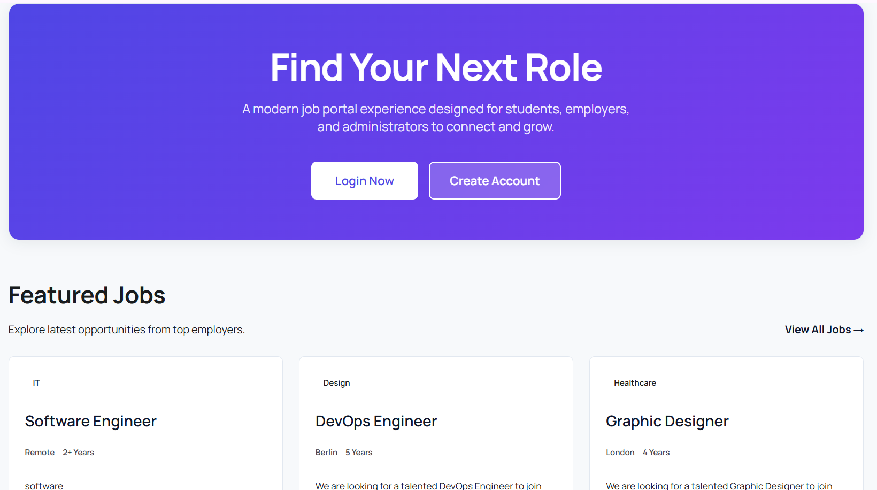
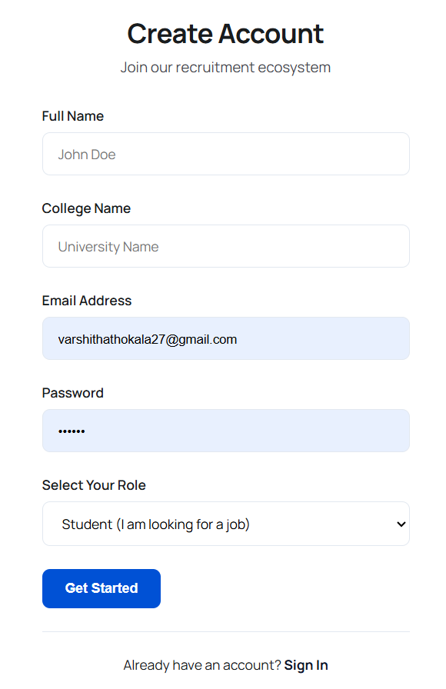
IMPLEMENTATION SCREENSHOTS
1
2
3
4
5
6
7
8
9

Slide 11
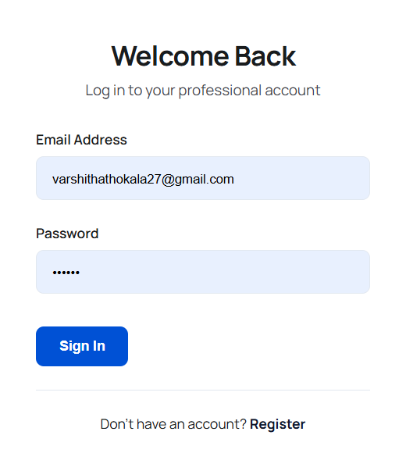
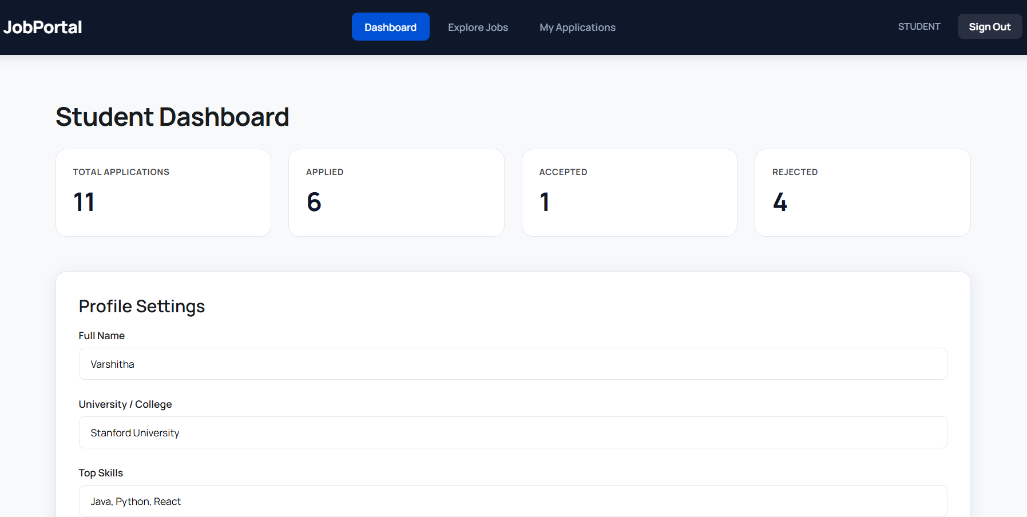
IMPLEMENTATION SCREENSHOTS
1
2
3
4
5
6
7
8(A)
9

Slide 12
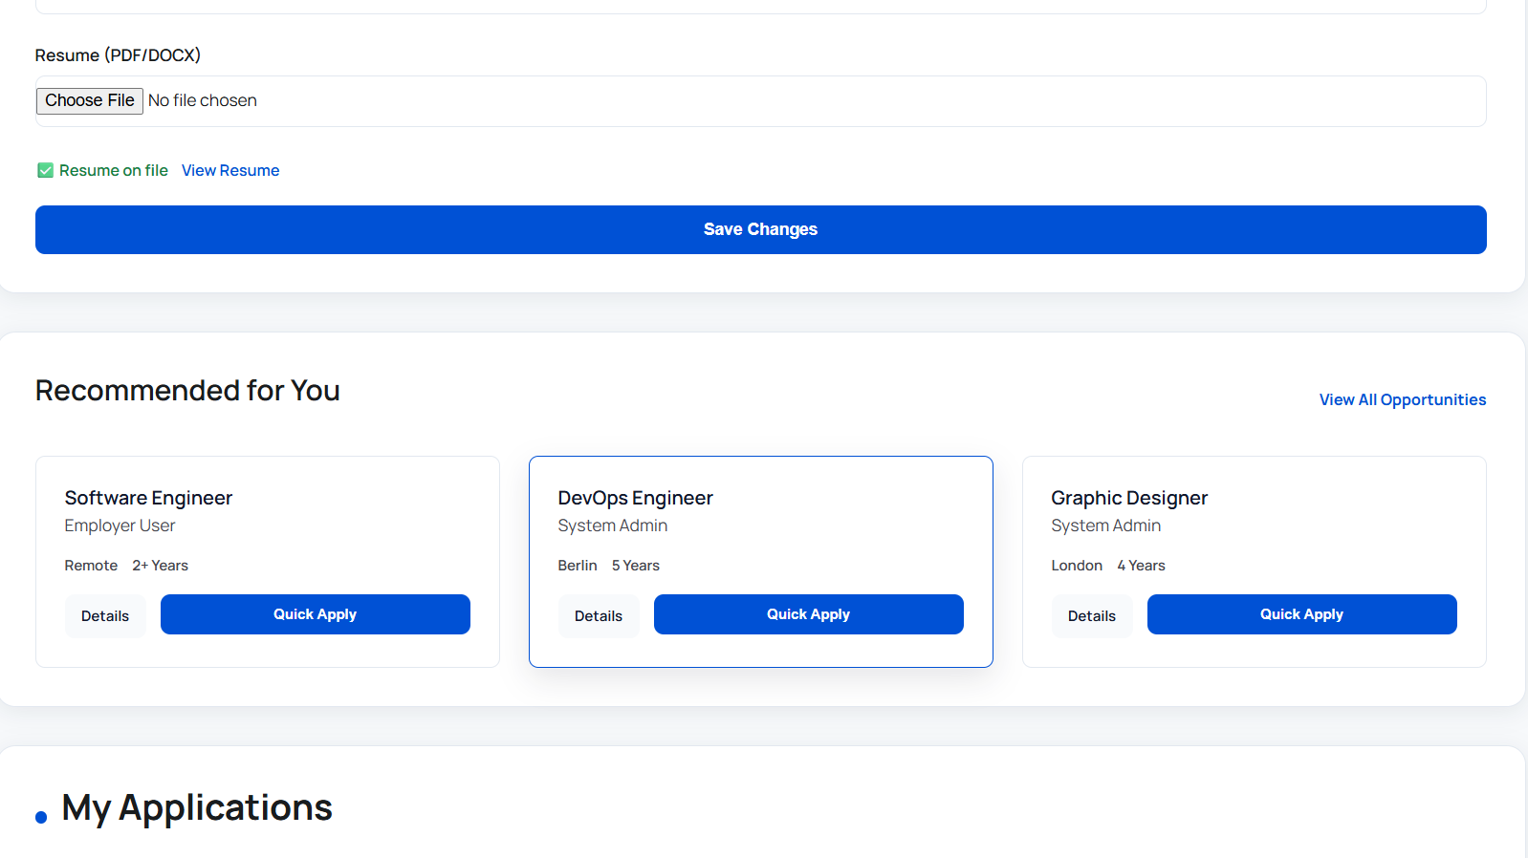
IMPLEMENTATION SCREENSHOTS
1
2
3
4
5
6
7
8(B)
9

Slide 13
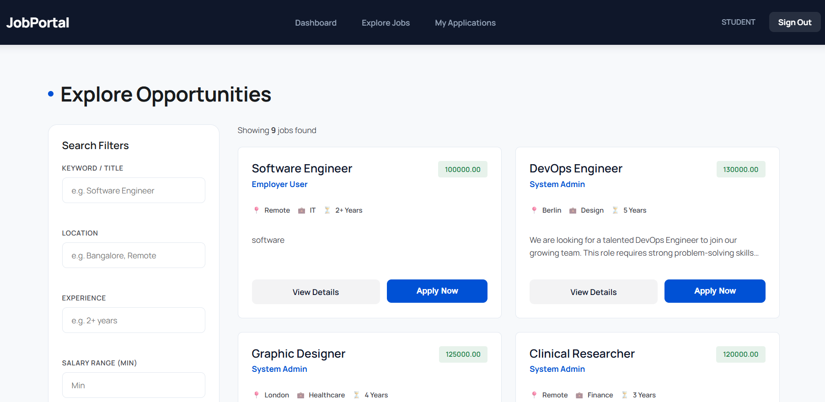
IMPLEMENTATION SCREENSHOTS
1
2
3
4
5
6
7
8(B)
9

Slide 14
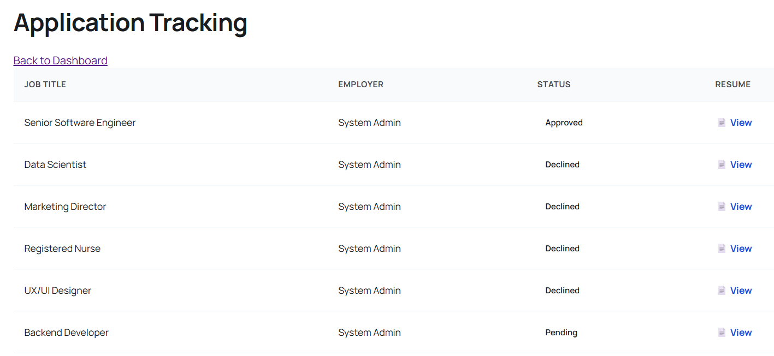
IMPLEMENTATION SCREENSHOTS
1
2
3
4
5
6
7
8(C)
9

Slide 15
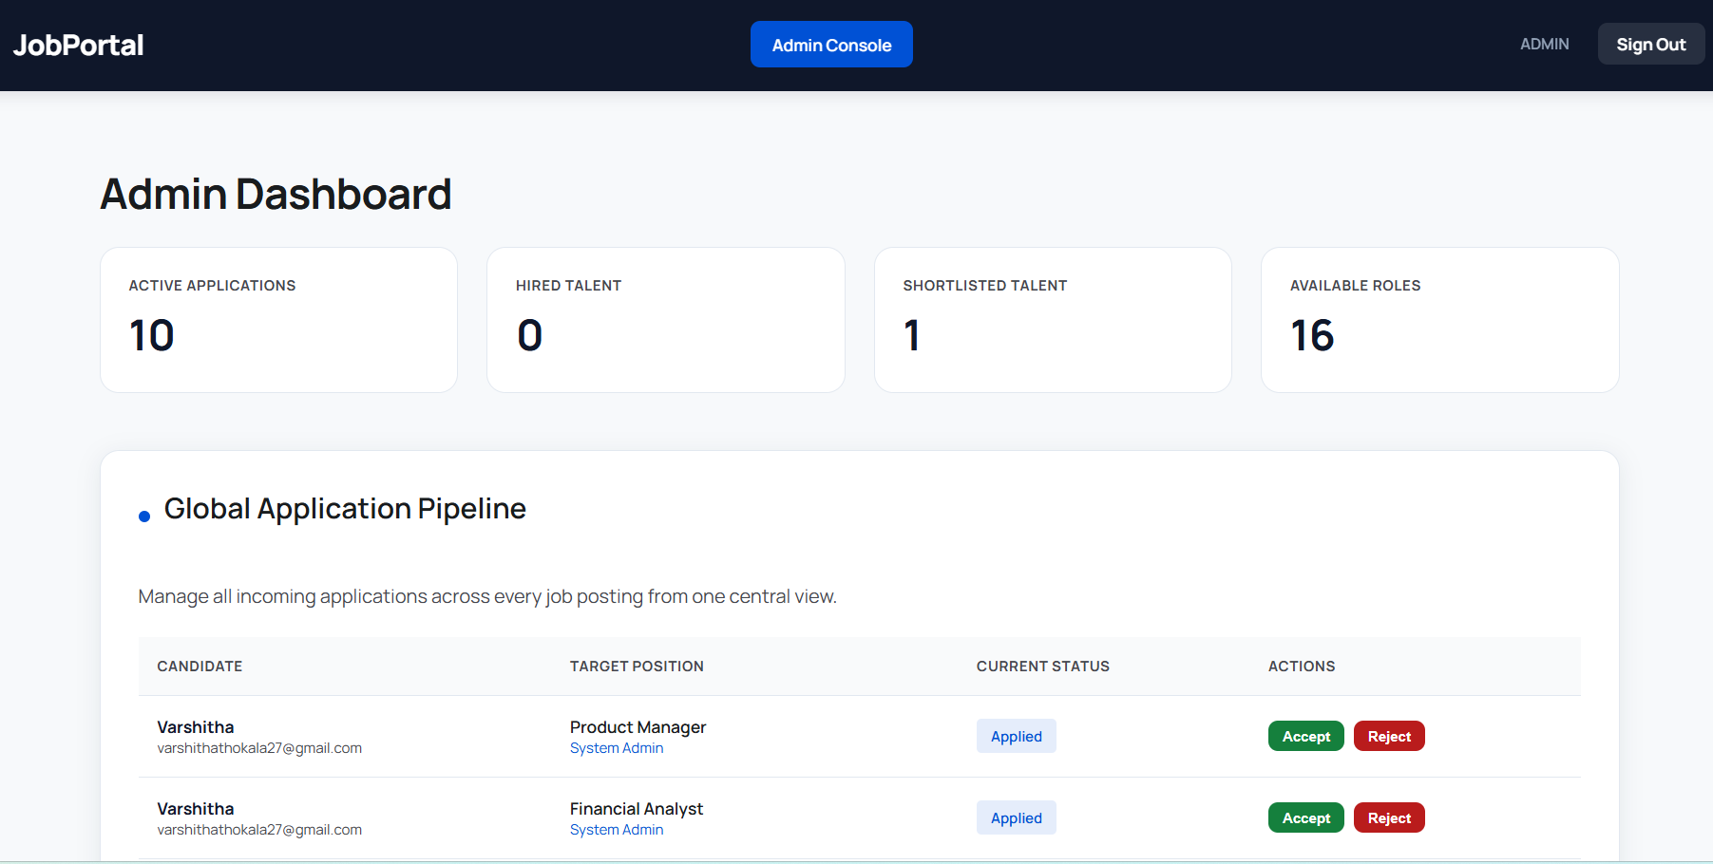
IMPLEMENTATION SCREENSHOTS
1
2
3
4
5
6
7
8(C)
9

Slide 16
ADVANTAGES & LIMITATIONS
1
Advantages
• Provides easy and quick access to quizzes/tests from anywhere. • Reduces manual work and saves time in evaluation. • Ensures secure data storage and user authentication. • Gives instant results and performance analysis. • Scalable system that can handle multiple users simultaneously. • Improves user experience with a responsive interface.
Limitations
• Requires a stable internet connection to function properly. • Initial setup and development can be time-consuming. • Security risks if not properly implemented (data breaches). • Limited offline functionality. • Performance may decrease with very high user load if not optimized. • Requires regular maintenance and updates.
2
3
4
5
6
7
8
9

Slide 17
THANK YOU

